Slide 1
IoT Device Security
MIS 689
Cyber Warfare
Capstone

Slide 2
Acknowledgements
OWASP: Open Web Application Security Project
ISACA: Information Systems Audit and Control Association
EC-Council

Slide 3
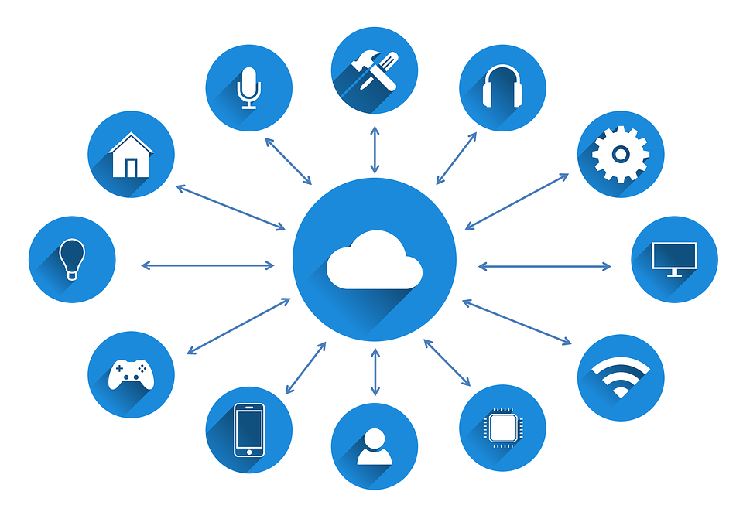
What Are IoT Devices?
An IoT device is simply an electronic device that is connected to the Internet.
There are several basic properties that qualify a device as an “IoT” device:
A physical device/object
Contains controller(s), sensor(s), and or actuator(s)
Connects to the Internet
Examples: Amazon Alexa, Samsung Smart TV, Google Home, NEST Security Camera
Generally labeled as “Smart Devices”

Slide 4
“Perfect Storm” for IoT Devices
Higher availability of internet access
Connection cost: Decreasing
More devices → Wi-Fi capabilities/sensors
Technology cost $$ → Decreasing

Slide 5
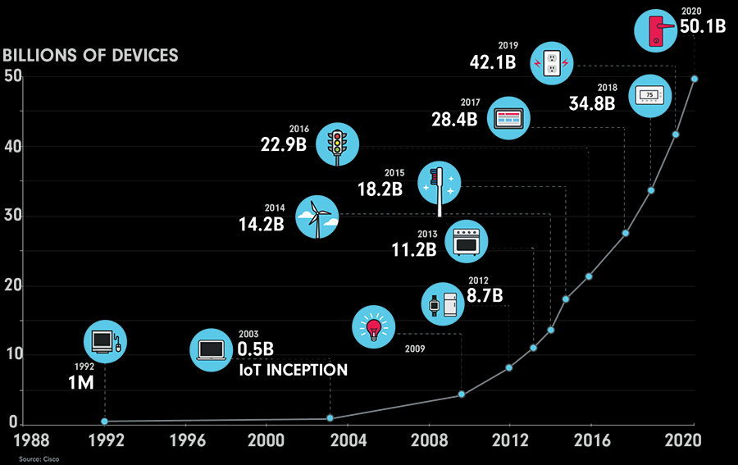
Trend in IoT Devices
Number of IoT Devices has surpassed the number of humans on the planet
Industries:
Personal/Consumer
Healthcare
Automotive
Manufacturing
Etc.
Figure 1: Growth in IoT Devices

Slide 6
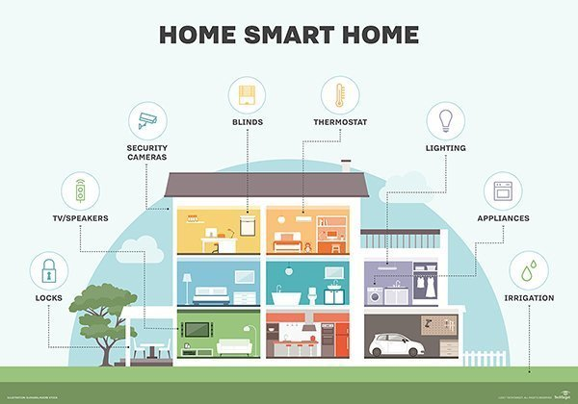
Home IoT Devices
Average number of devices per person:
8 devices per person (Cisco VNI 2018)
https://internetofthingsagenda.techtarget.com/definition/smart-home-or-building

Slide 7
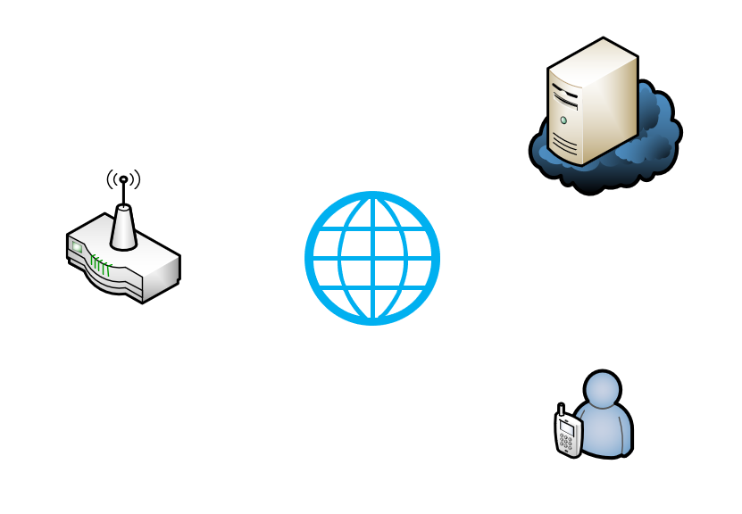
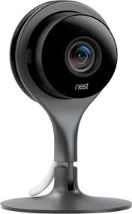
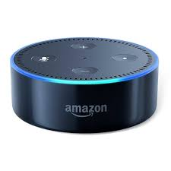
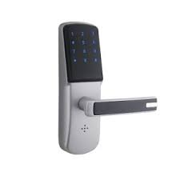
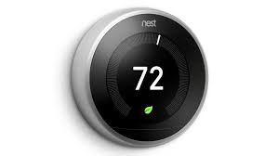
IoT Communication
Store Data
Cloud Storage Server
Send Data
Send Data
Receive Command
Gateway
Internet
Receive Data
Send Command
User/Device Controller
IoT Devices
Figure 3: IoT Communication

Slide 8
Application
Sector | Types of Devices | Locations
Smart Grid | Energy Generators, Turbines, Windmills, Batteries, Fuel Cells | Oil Rigs, Derricks, Pipelines, Solar Panels, Wind Turbines, Electrical Grids
Smart Transportation | Vehicles, Lights, Ships, Planes, Tolls, Parking Meters | Air, Rail, Marine, Consumer Vehicles, Commercial Vehicles, Navigation
Retail | POS Systems, Cash Registers, Vending Machines, Tags | Cinemas, Shopping Malls, Cafes, Restaurants, Supermarkets, Distribution Centers, Bars
Healthcare | MRI, Implants, CGM, Pacemaker | Hospitals, ER, Clinic, Doctor Office, Labs
Consumer/Home | Digital Cameras, e-Readers, Dishwashers, Refrigerators, Game Consoles | Wiring, Network Access, Fire Safety, HVAC/Climate, Lighting, Entertainment

Slide 9
OWASP – Top 10 IoT Risks and Vulnerabilities
Vulnerability/Risk | Description
1. Weak, Guessable, Hardcoded Passwords | Using easily brute-forced, publicly available, or unchangeable credentials
2. Insecure Network Services | Unneeded or insecure network services running on the device itself, especially those exposed to the internet, compromise the C.I.A. of information or allow unauthorized remote control
3. Insecure Ecosystem Interfaces | Insecure web, backend API, cloud, or mobile interfaces in the ecosystem outside of the device that allows compromise of the device or its related components.
4. Lack of Secure Update Mechanism | Lack of ability to securely update the device. Examples include lack of firmware validation on device, lack of secure delivery (plaintext transmission), lack of anti-rollback mechanisms
5. Use of Insecure or Outdated Components | Using deprecated or insecure software components/libraries that could allow the device to be compromised. Includes insecure customization of OS platforms, using third-party software, etc.
6. Insufficient Privacy Protection | User’s personal information is stored on the device and is used insecurely or without permission
7. Insecure Data Transfer and Storage | Lack of encryption or access control of sensitive data anywhere within the ecosystem, including at rest, in transit, or during processing
8. Lack of Device Management | Lack of security support on devices deployed within production, including asset management, update management, secure decommissioning, systems monitoring, and response capabilities
9. Insecure Default Settings | Devices or systems shipped with insecure default settings or lack the ability to make the system more secure by restricting operators from modifying configurations
10. Lack of Physical Hardening | Lack of physical hardening measures, allowing potential attackers to gain sensitive information that can help in future remote attacks or take local control of the device

Slide 10
IoT Attack Surfaces
Attack Surface | Vulnerability
Ecosystem Access Control | Implicit trust between components Enrollment security Lost access procedures
Device Memory | Cleartext usernames Cleartext passwords Third-party credentials
Device Physical Interfaces | User CLI Admin CLI Privilege escalation
Device Web Interface | SQL Injection XSS Weak Passwords
Device Firmware | Hardcoded credentials Sensitive information disclosure Encryption keys

Slide 11
IoT Attack Surfaces (Cont.)
Attack Surface | Vulnerability
Device Network Services | Denial of Service Buffer Overflow Poorly implemented encryption
Administrative Interface | SQL Injection Account lockout Two-factor authentication
Local Data Storage | Unencrypted data Data encrypted with discovered keys Lack of data integrity checks
Cloud Web Interface | SQL Injection Weak passwords Username enumeration
Third-party Backend APIs | Unencrypted PII sent Device information leaked Location leaked

Slide 12
IoT Attack Surfaces (Cont.)
Attack Surface | Vulnerability
Update Mechanism | Update sent without encryption Updates not signed Missing update mechanism
Mobile Application | Implicitly trusted by device or cloud Insecure data storage Insecure password recovery mechanism
Vendor Backend APIs | Inherent trust of cloud or mobile application Weak access controls Weak authentication
Ecosystem Communicaiton | Health checks Ecosystem Commands Pushing updates
Network Traffic | LAN LAN to Internet Short range

Slide 13


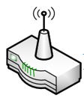
Example: IoT Attack Scenario
Server
Fake Server
Eavesdropping
Network
Fake Devices
Devices

Slide 14
Defensive Security Measures – IoT
Category | IoT Security Consideration
Insecure Web Interface | Disallow weak user passwords Provide an account lockout mechanism Test interface for SQL injection, XSS, CSRF vulns
Insufficient Authentication/Authorization | Require strong passwords for authentication Implement two-factor authentication Force password expiration after a certain date
Insecure Network Services | Ensure all devices operate with minimal ports active Ensure devices do not make network ports or services available to internet via UPnP Review required network services for vulnerabilities
Lack of Transport Encryption | Ensure traffic is encrypted between system components Ensure SSL/TLS implementations are updated and configured properly
Privacy Concerns | Ensure only minimal amount of PII is collected from consumers Ensure only non-sensitive data is analyzed Ensure data retention policy is in place

Slide 15
Defensive Security Measures – IoT (Cont.)
Category | IoT Security Consideration
Insecure Cloud Interface | Ensure all cloud interfaces are reviewed for vulnerabilities Ensure any cloud-based web interface disallows weak passwords Ensure all cloud interfaces use transport encryption
Insecure Mobile Interface | Ensure that any mobile application disallows weak passwords Ensure that any mobile application has an account lockout mechanism Implement two-factor authentication for mobile applications
Insufficient Security Configurability | Ensure password security options are made available (e.g. Enabling 20 character passwords or enabling two-factor authentication) Ensure encryption options are made available (e.g. Enabling AES-256) Ensure secure logging is available for security events
Insecure Software/Firmware | Ensure all system devices have update capability and can be updated quickly when vulnerabilities are discovered Ensure update files are encrypted and that the files are also transmitted using encryption
Poor Physical Security | Ensure the device is produced with a minimal number of physical external ports (e.g. USB ports) Ensure the firmware of Operating System can not be accessed via unintended methods such as through an unnecessary USB port Ensure the product is tamper resistant

Slide 16
Case: Dyn Botnet DDoS Attack
DDoS Attack in October, 2016 → Target: DNS provider Dyn
DDoS attack was staged and launched from IoT devices using the Mirai malware
Mirai was designed for two main purposes:
Find and infect IoT devices to grow the botnet
Participate in DDoS attacks based on commands received by remote Command and Control (C&C) infrastructure
Mirai operates in three stages:
Infect the device
Protect itself
Launch attack

Slide 17
Case: Dyn Botnet DDoS Attack (Cont.)
Stage 1: Scan for IoT devices that are accessible over the Internet
Primarily scans for ports 22, 23, 5747, etc. that are open
Can be configured to scan for others
Once connected → brute-forces usernames and passwords to login to the device
Use the device to scan networks looking for more IoT devices

Slide 18
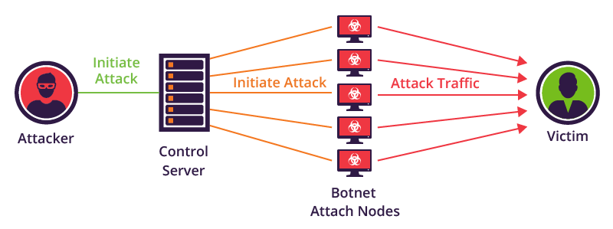
Case: Dyn Botnet DDoS Attack (Cont.)
https://www.imperva.com/blog/how-to-identify-a-mirai-style-ddos-attack/

Slide 19
Case: Dyn Botnet DDoS Attack (Cont.)
Stage 2: Protect itself
Kill other process running on infected device (SSH, Telnet, HTTP) to prevent owner from gaining remote access to device while infected
Note: Rebooting the device can remove the malware, but it can become infected again
Stage 3: Launch attack
Infected device launches different types of attacks
HTTP floods, SYN floods, etc. → DDoS-based attacks
**Note: Mirai contained a list of known networks in the U.S. to avoid attacking → U.S. Postal Service, Department of Defense

Slide 20
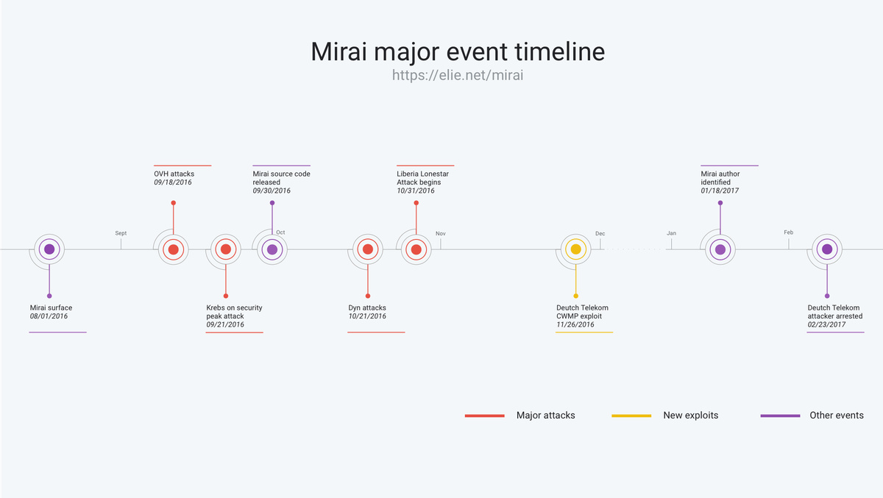
Case: Dyn Botnet DDoS Attack (Cont.)
https://blog.cloudflare.com/inside-mirai-the-infamous-iot-botnet-a-retrospective-analysis/

